Slide 1

PROJECT
PRESENTATION
SK Broadband x Sungkyunkwan University
강민구
문경진

Slide 2

TEAM INTRODUCTION
Professor and Assistant
Students
Company

Slide 3
TEAM INTRODUCTION
Professor : 황지영
Research topics: Big data, Data Mining,
Machine Learning, Social Network Analysis
Assistant : 정상원

Slide 4
TEAM INTRODUCTION
Name | Major | Task
문경진 | Computer engineering, Junior | Analyze existing research about clustering and recommendation system
강민구 | Software, Sophomore | Data preprocessing and analyzation
구자현 | Software, Sophomore | Realize and estimate clustering and recommendation system
김한별 | Software, Sophomore | Algorithm performance evaluation and optimization
석은주 | Software, Freshman | Source code analyzation and using of open source recommendation system

Slide 5

TEAM INTRODUCTION
SK broadband formerly hanaro telecom is a telecommunication company. It’s a one of the biggest broadband internet access provider providing services like Giga Internet, IPTV service.

Slide 6
GOAL OF PROJECT
Previous Research
Goal of Project

Slide 7
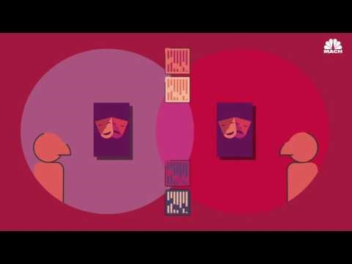
GOAL OF PROJECT

Slide 8
GOAL OF PROJECT
Last year, SK broadband educational-industrial cooperation team made a system that predicts viewer at particular time periods
It shows high percentage of accuracy

Slide 9
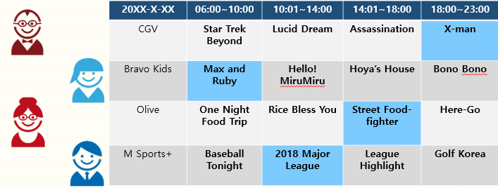
GOAL OF PROJECT

Slide 10
GOAL OF PROJECT
Make recommender system for viewers at particular time periods in succession to previous research
To achieve our goal, we will use watching data of IPTV users.

Slide 11
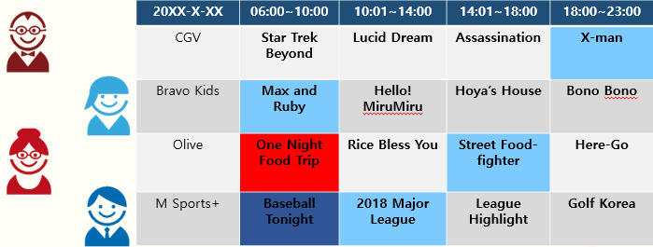
GOAL OF PROJECT

Slide 12
PROCESS
OF OUR
PROJECT
May
START
Set goal of team
Subdividing plan

Slide 13
June
Study and research various clustering algorithm
START
PROJECT
July
User clustering using watching history data

Slide 14
August
User clustering using watching history data
START
PROJECT
September
Study and research recommender system algorithm

Slide 15
October
Realize channel recommender system based upon clustered data
START
PROJECT
November
System performance evaluation and result analysis

Slide 16
PROCESS
OF OUR
PROJECT
December
FINISH
Suggest improvement point and future direction of research

Slide 17
MAIN TASK
Clustering watching data
Implement recommender system using collaborative filtering
Performance checking, drawing conclusion

Slide 18




MAIN TASK
1) Clustering watching data

Slide 19





MAIN TASK
2) Implement recommender system using collaborative filtering
Recommen-dation!
 | Item1 | Item2 | Item3 | Item4 | Item5 | Item6 | item7
A | 5 | 2 | - | 1 | - | 5 | 4
B | - | 4 | 4 | - | 1 | 2 | 5
C | - | 4 | 5 | - | 2 | 2 | ?
D | 4 | 2 | - | 1 | - | 5 | ?

Slide 20
MAIN TASK
Clustering
Grouping a set of objects in such a way that objects in the same group are more similar to each other than to those in other groups
In our project, Clustering Algorithm is used to predict who is watching program.
K-means (unsupervised), K-NN (supervised), etc

Slide 21
MAIN TASK
K-means Clustering

Slide 22



MAIN TASK
K-means Clustering

Slide 23

MAIN TASK
K-NN
Perspective of blue circle (new data)
If k=3, $c∈Green Set$
If k=5, $c∈Yellow Set$
k=5
k=3

Slide 24
MAIN TASK
Recommender System
Subclass of information filtering system that seeks to predict the rating or preference a user would give to an item
Intuition : using similar preference patterns
Using Collaborative Filtering, recommend channel to user!

Slide 25
MAIN TASK
Collaborative Filtering
Given a target user, find a set of users whose preference patterns are similar to the preference pattern of the target user

Slide 26





MAIN TASK
?

Slide 27
MAIN TASK
Using user-item table
 | Search | Monstrum | Along with the Gods | Adrift | The Witness | The spy gone north | Molly’s Game
A | 5 | 2 | - | 1 | - | 5 | 4
B | - | 4 | 4 | - | 1 | 2 | 5
C | - | 4 | 5 | - | 2 | 2 | ?
D | 4 | 2 | - | 1 | - | 5 | ?

Slide 28
TIME TABLE (FIRST PART)
 | Date | Plan
Week 1 | 09/02~09/08 | Reviewing Clustering Algorithms (K-means and its Variation)
Week 2 | 09/09~09/15 | Studying K-NN Clustering Algorithm
Week 3 | 09/16~09/22 | Studying Machine Learning Library : Sklearn and other open sources
Week 4 | 09/23~09/29 | Implementation of Clustering Algorithms
Week 5 | 09/30~10/06 | Studying Recommender System and CF(Collaborative Filtering)
Week 6 | 10/07~10/13 | Implementation of CF on Clustered Data
Week 7 | 10/14~10/20 | Implementation of CF on Clustered Data
Week 8 | 10/21~10/27 | Implementation of Entire Recommender System

Slide 29
TIME TABLE (SECOND PART)
 | Date | Plan
Week 9 | 10/28~11/03 | Implementation of Entire Recommender System
Week 10 | 11/04~11/10 | Implementation of Entire Recommender System
Week 11 | 11/11~11/17 | Performance Measurement & Result Analysis
Week 12 | 11/18~11/24 | Performance Measurement & Result Analysis
Week 13 | 11/25~12/01 | Finding Improvements & Setting Direction of Following Studies
Week 14 | 12/02~12/08 | Finding Improvements & Setting Direction of Following Studies
Week 15 | 12/09~12/15 | Co-op Project Presentation

Slide 30
CHECKPOINT
Clustering issues
We don’t know that how many people each family has. How to set k value for k-means clustering to detect viewer?
Overlapping or not : Allow data to be included in multiple viewer group?

Slide 31
FINISH
OUR PRESENTATION THANK YOU

